Slide 1
NFB CIO

Slide 2

Empower every person and every organization on the planet to achieve more

Slide 3

SharePoint and our Vision
Powerful product + Flexible platform = Customizations

Slide 4

Rethink SharePoint: Modernize and Simplify

Slide 5

Trusted Tester Program
Compressed shipping times
Improvements/fixes driven every week
Embedded into our process

Slide 6

Doing things right
Delaying the shipping of a feature because of accessibility is the right thing to do!

Slide 7

Inclusive Design from Day 1
Accessibility 1-2-3
Predictable and efficient keyboard navigation
Intuitive Narration
Color Contrast

Slide 8

Seeking and acting on feedback: Usability testing

Slide 9
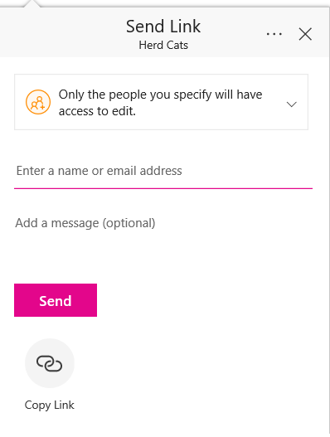
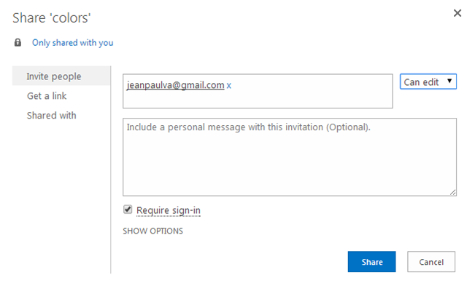
Compliance vs. Usable: Sharing Documents

Slide 10

Designing for the limits makes the experience delightful for everyone!

Slide 11

Documentation
Updated statements for the requirements of Section 508, WCAG 2.0 AA, EN 301 549
Help articles that teach users how to do the most important tasks​

Slide 12

What have we succeeded in delivering for you?

Slide 13

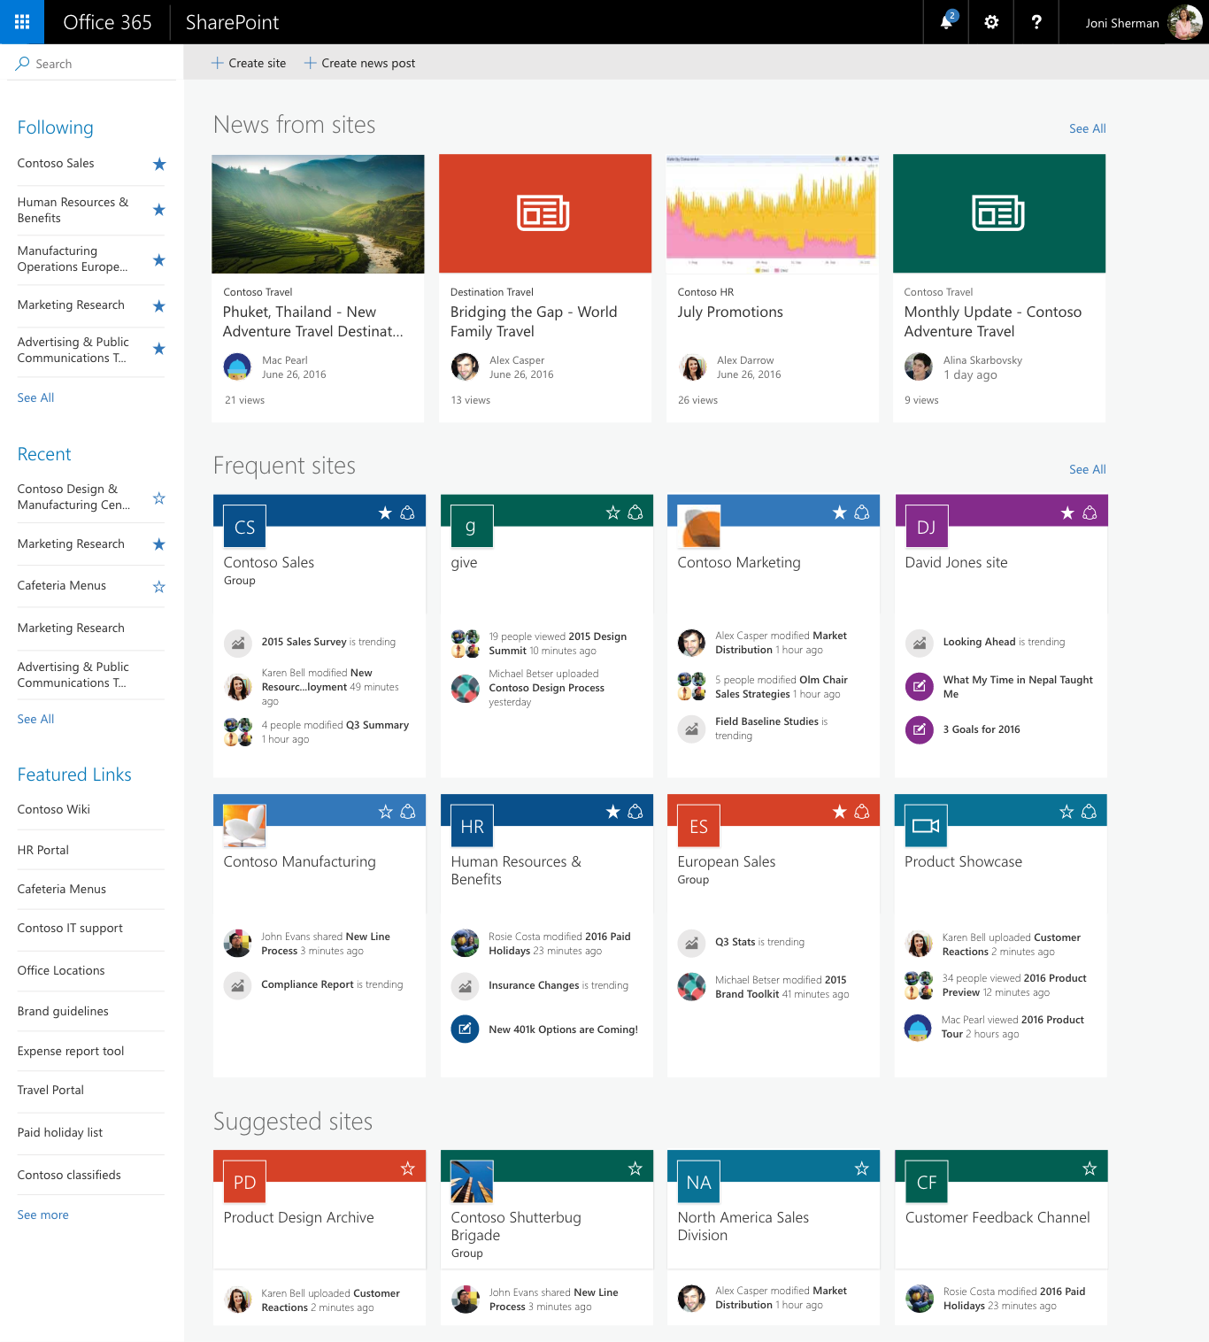
Enhanced SharePoint Home

Slide 14

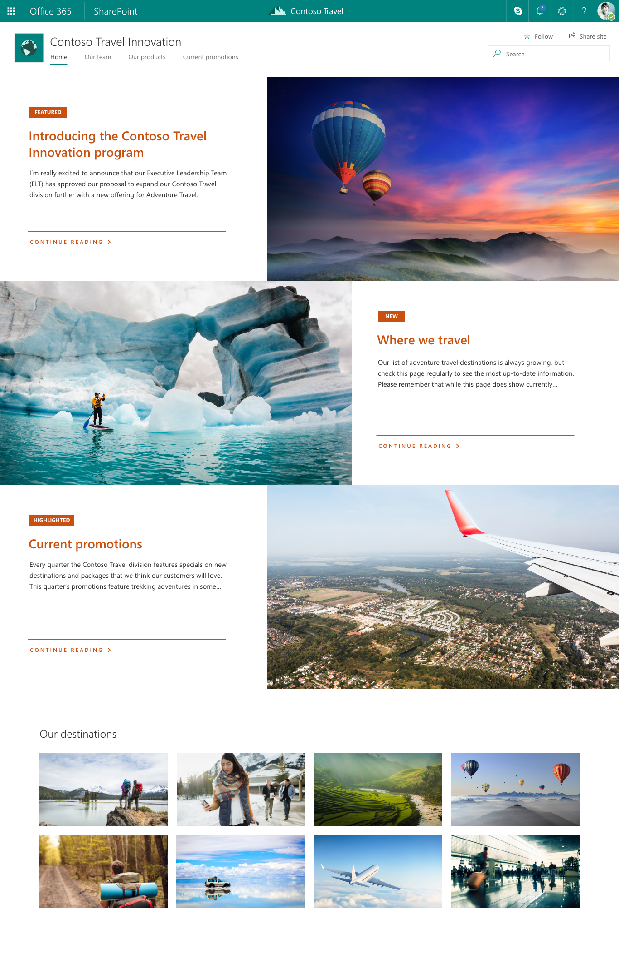
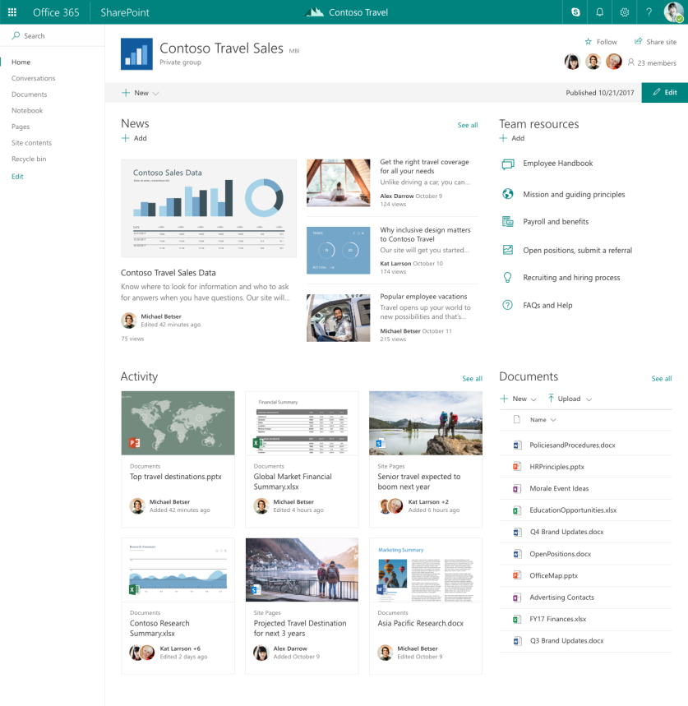
Team Sites and Communication Sites

Slide 15

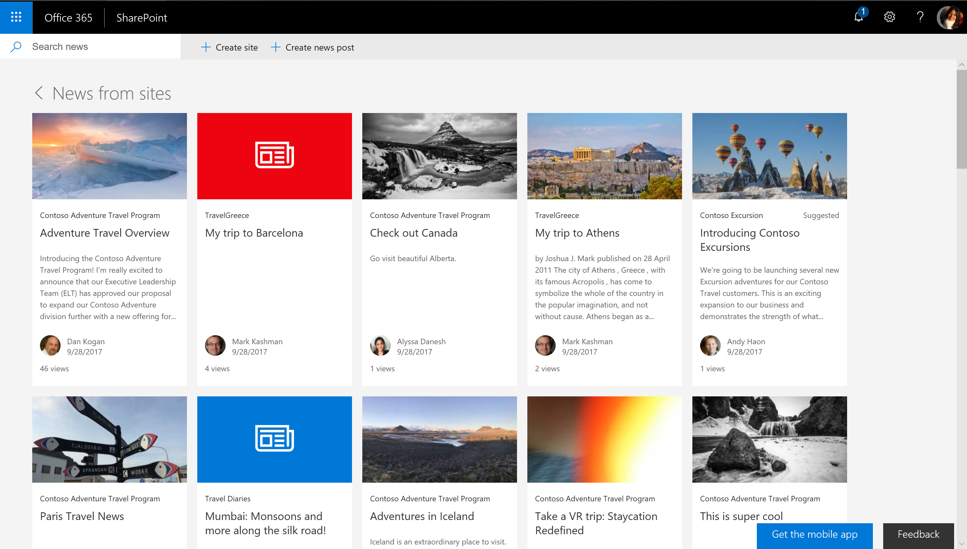
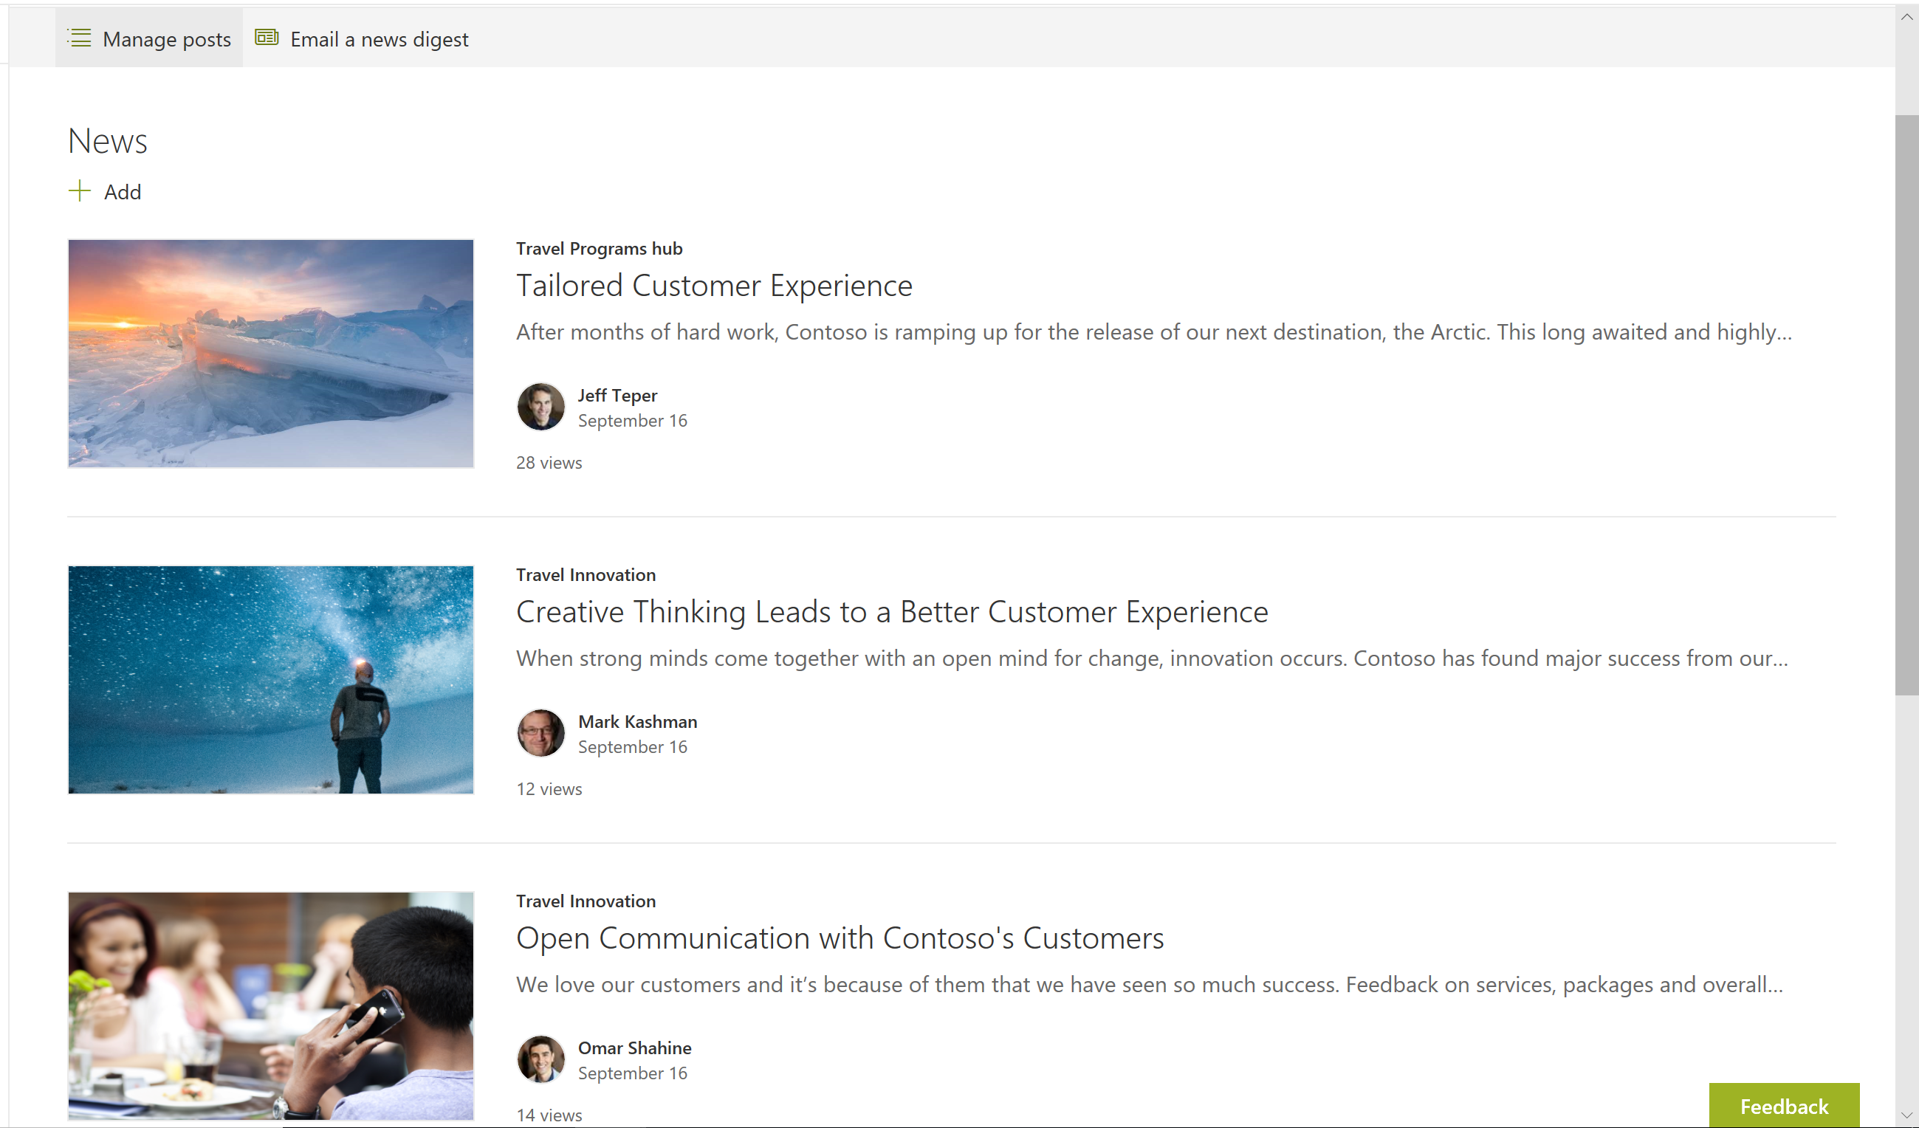
Personalized News and Team News

Slide 16

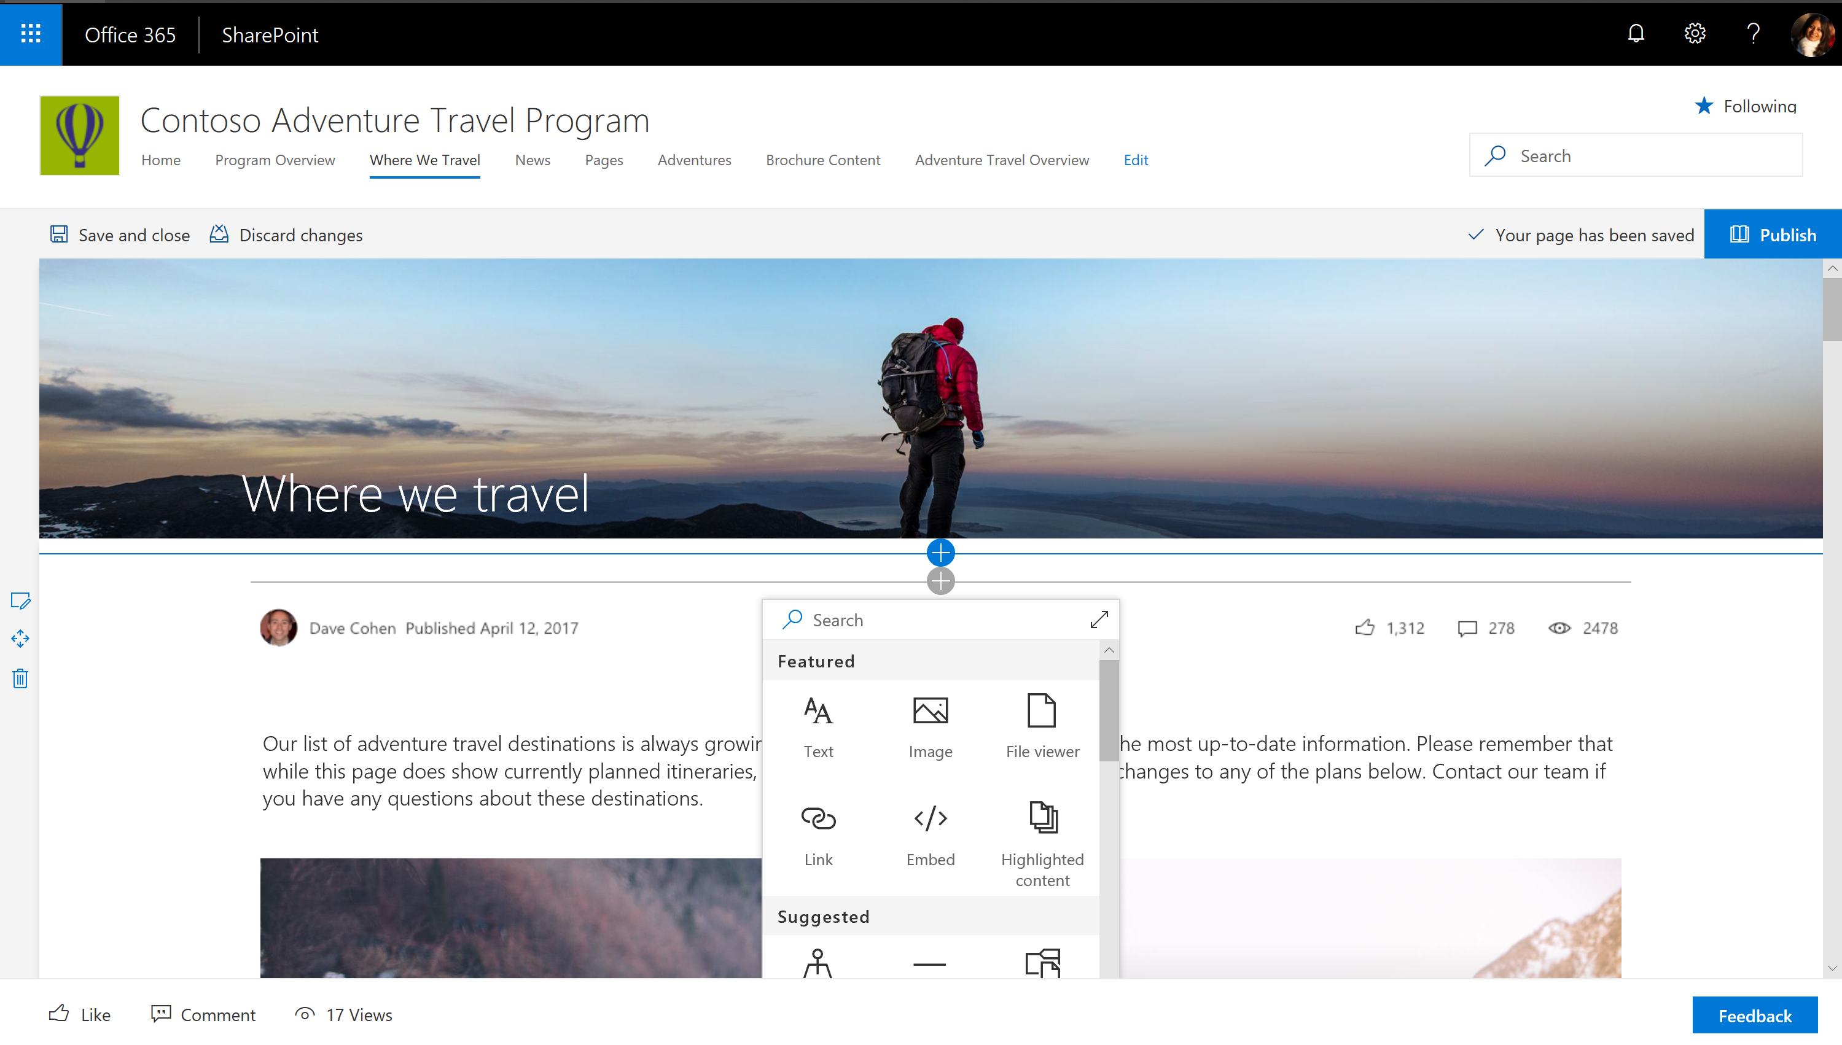
Enhanced toolkit for modern page and news authoring

Slide 17

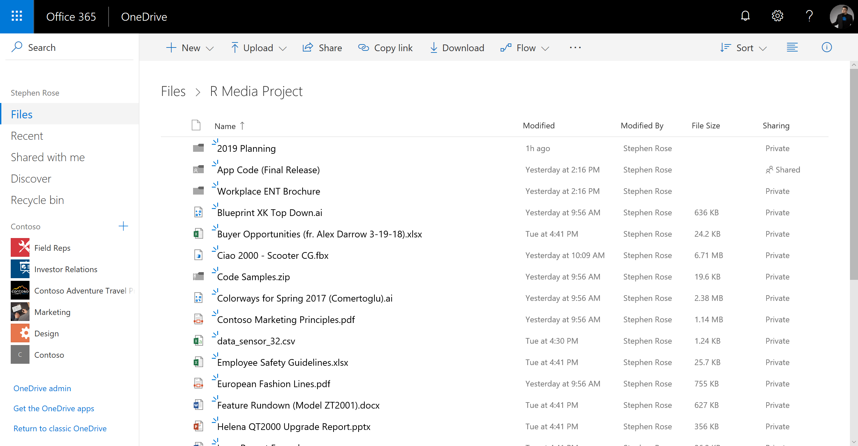
Modern Lists and Libraries

Slide 18

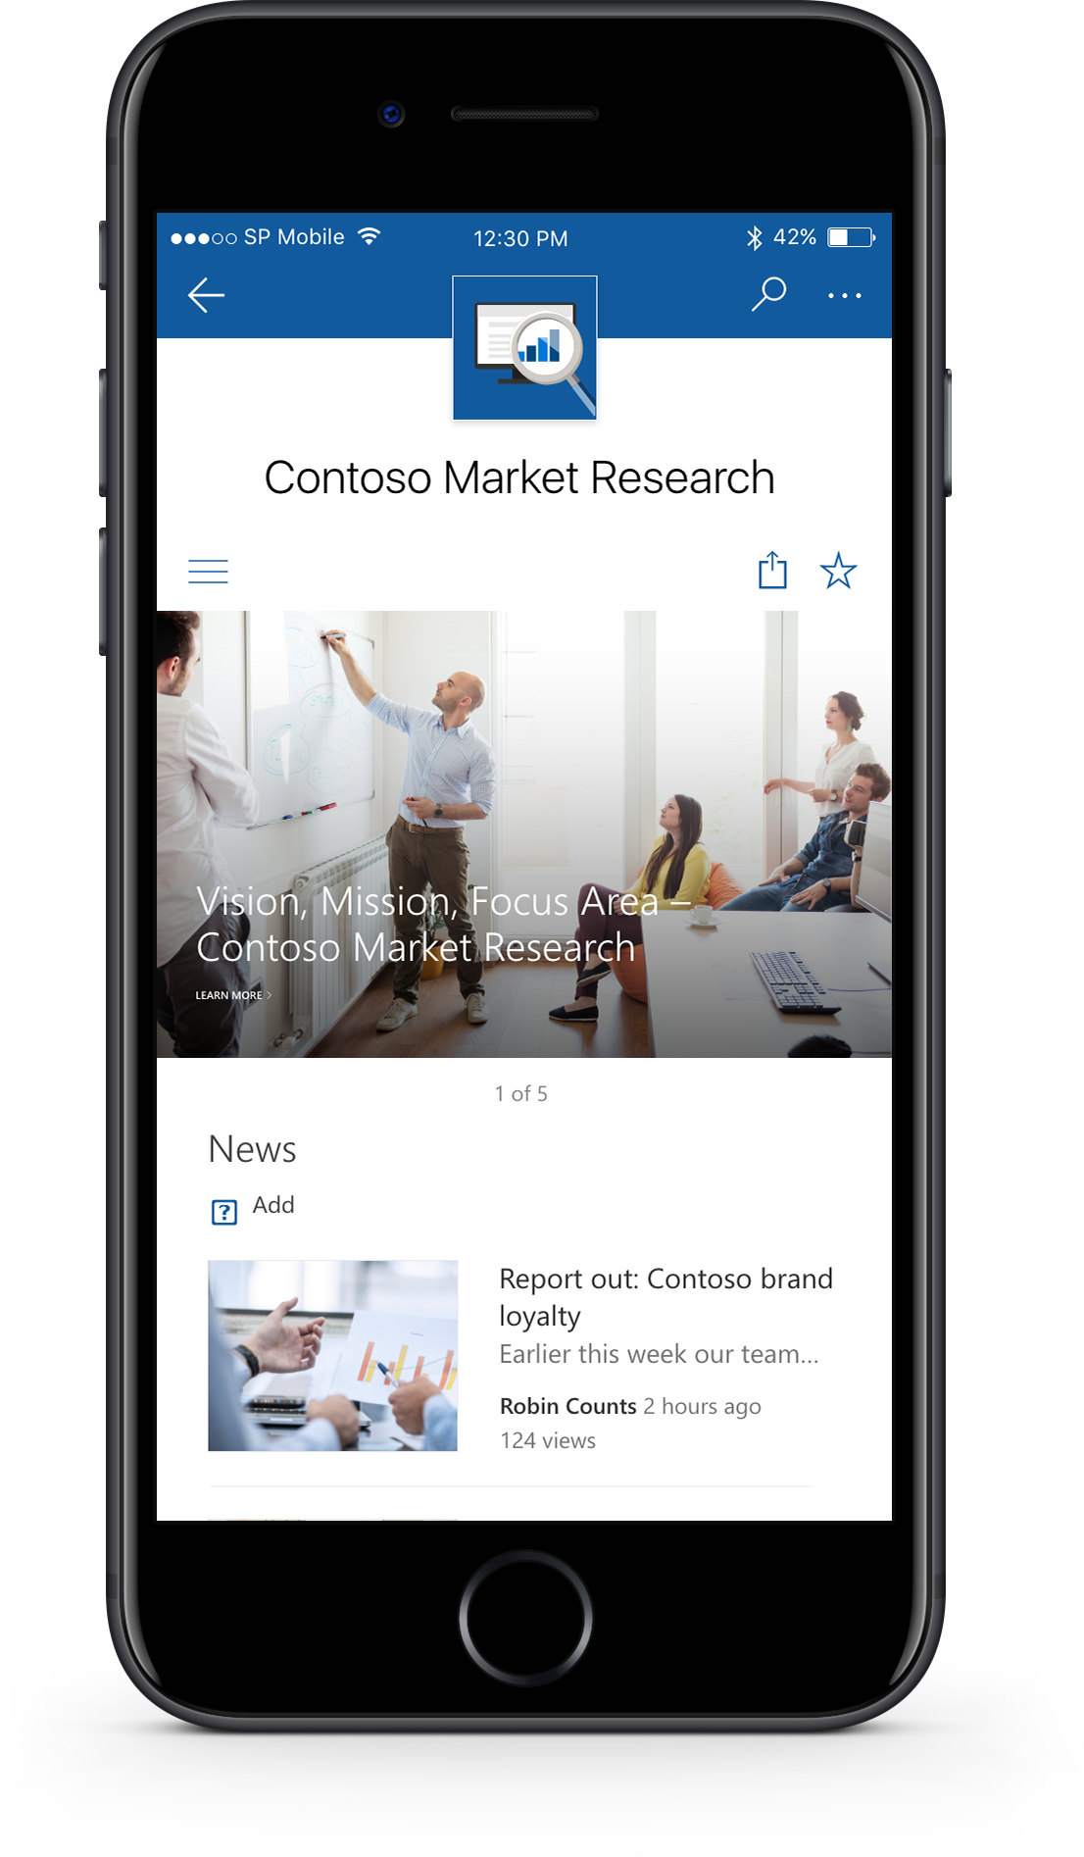
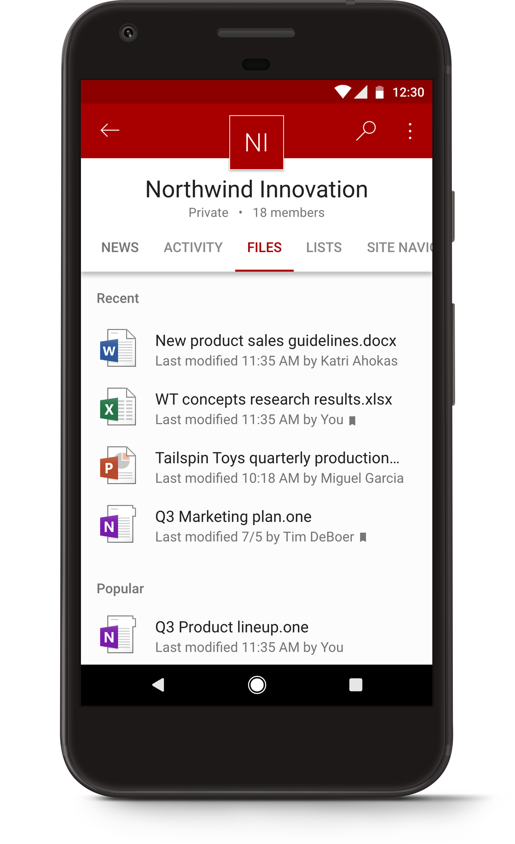
Mobile apps

Slide 19

Up next
Page authoring accessibility checker
Automatic alternative text generation for images

Slide 20
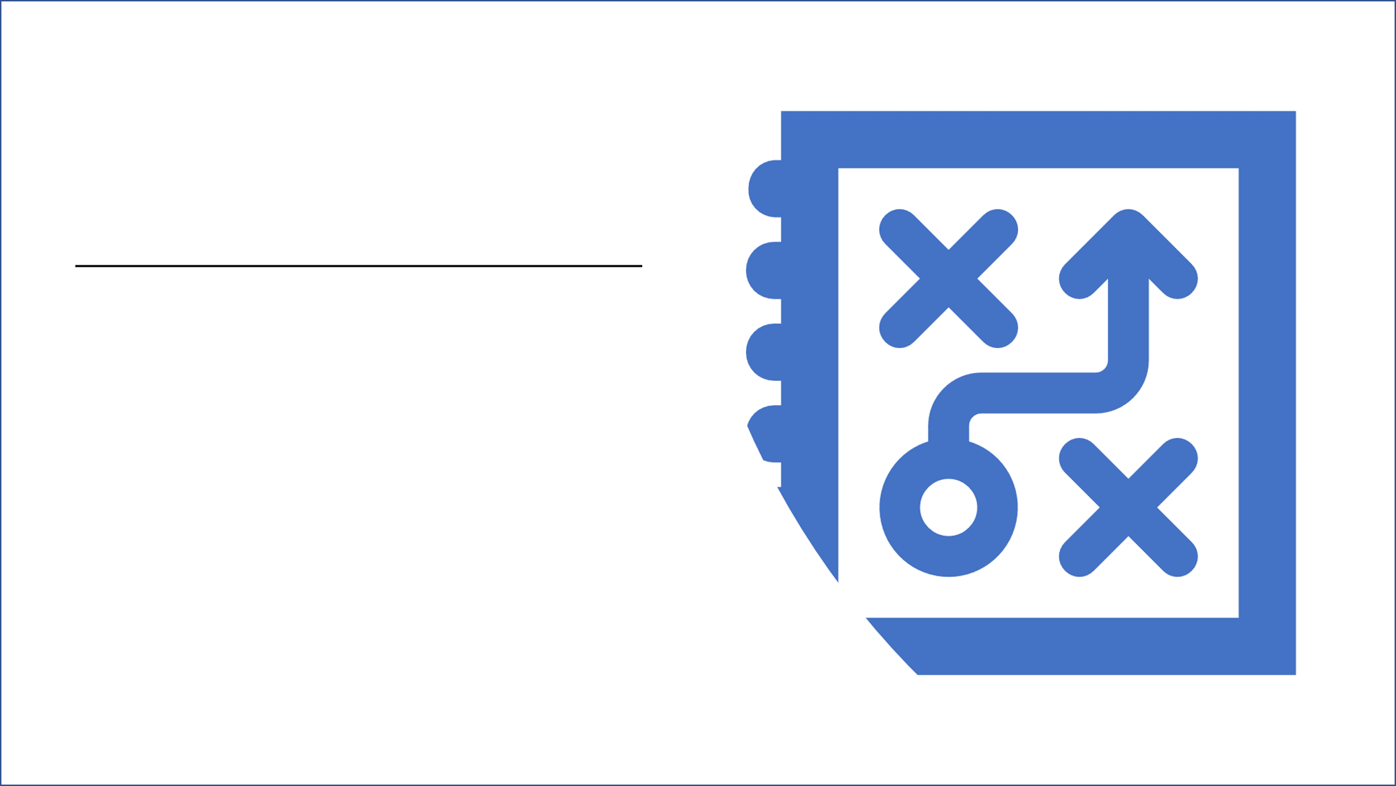
How do you take advantage of all our improvements on the cloud?

Slide 21

Cloud is here…
Questions remain:
What does this mean for my IT strategy?
What does this mean for SharePoint?
For what scenarios should I use the cloud?

Slide 22

Journey to innovation, on-premises
SharePoint Server 2016 + Feature Packs
Hybrid
Migration

Slide 23

Cloud born Cloud scale and performance with SharePoint Server 2016

Slide 24

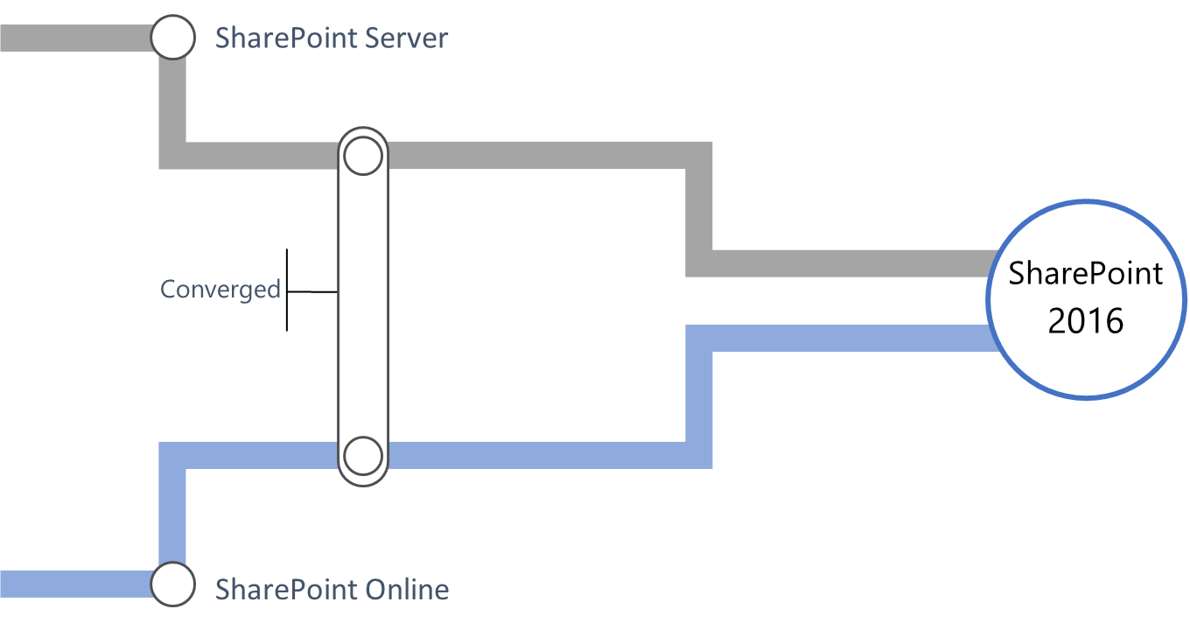
Converged codebase

Slide 25

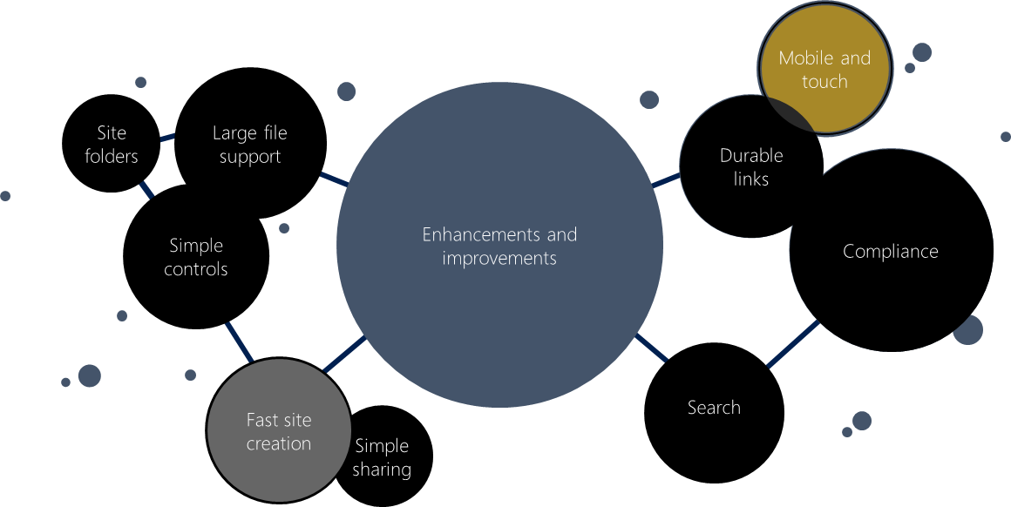
Cloud accrued capabilities

Slide 26


SharePoint 2016 Release cadence
Release | Frequency | Contents
Security Update | As required | Security fixes
Public Update | Monthly | Bug fixes, selected new features from cloud
Major Release | Every 2-3 years | New features

Slide 27

IT
IW
MinRole enhancements
Administrative action logging
Hybrid taxonomy
Hybrid auditing
OneDrive for business user experience
Custom app launcher tiles

Slide 28
IT
SharePoint Framework client side web part

Slide 29



SharePoint Server 2019
Built on the foundational release of SharePoint 2016
Brings you closer to the cloud
Brings the cloud closer to you

Slide 30

Getting started with cloud… Hybrid configuration

Slide 31

What is hybrid?
Hybrid provides connective tissue between SharePoint on-premises and Office 365
Business value
Bring cloud innovation to on-premises
Migration to the cloud
Migrate at your own pace

Slide 32



Why start with hybrid?
Simple configuration
Customers who implement hybrid scenarios when migrating to Office 365 see higher cloud usage
40% of SharePoint On-Premises customers use one or more hybrid scenarios and it is increasing
Anywhere, anytime access to people and content
Seamless integration with familiar collaboration tools
Enterprise-grade security, compliance, and IT control

Slide 33
The scope of hybrid capabilities…
App discovery
App Launcher
Apps
OneDrive for Business
Yammer
Sites (Intranet/Extranet)
Office 365 Video
Delve
Selectively redirect users to OneDrive for Business in Office 365
Provide access to modern mobile apps across devices and platforms
Enable real-time data access 24x7
Enable organizations conversations in the cloud
Embed conversations on-premises in SharePoint Server 2013 and SharePoint Server 2016
Enable modern sites creation by defaulting self-service sites to SPO
Provide a single, aggregate view of site membership across cloud and on-premises
Leverage SPO B2B to extend collaboration to partners, say goodbye to on-premises infrastructure
Enable real-time streaming and digital media distribution
Embed videos on-premises in SharePoint Server 2013 and SharePoint Server 2016
Enable contextual discovery of content and people across on-premises and cloud
Data discovery
Search
Unified Auditing*
Unified Taxonomy & Content Type
All capabilities available in SP 2013 & 2016 (*Unified Auditing is only in SP 2016)

Slide 34

Migration to the cloud Preparing to move to the cloud

Slide 35


Assessment
What do I have?
What to leave behind
Assessment
Mitigation Plan
Migration Plan

Slide 36
Get started with migration assessment…
SharePoint 2013 Migration Assessment Tool
https://www.microsoft.com/en-us/download/details.aspx?id=53598
SharePoint 2010 Migration Assessment Tool
https://www.microsoft.com/en-us/download/details.aspx?id=54681

Slide 37



Inventory Collection
Manual Inventory
1st Party Tools
3rd Party Tools
Manual inventory and data collection across known sources and locations
Programmatic, automatic inventory and data collection across known sources and locations with Microsoft solutions and guidance
Programmatic, automatic inventory and data collection across known and unknown sources and locations through Microsoft trusted partners

Slide 38

Start Making a Plan
Leverage the information you collected to better plan
Leave behind
Migrate
Rebuild
Don’t bring what you don’t need anymore
Look for content that hasn’t been modified in a while
All those things that can be migrated to the new location without a lot of rework
Sometimes, it’s better to rebuild something and benefit from newer features to better solve our problem

Slide 39
Migration Tool Spectrum
Each migration has unique needs
Your assessment will help you determine what tool is right for you
Apps
Folders & Files
Features
Security & metadata
Features
Security & metadata
Folders &
Files
Apps
Amount of Content
Complexity/Effort to Migrate

Slide 40











Migration Tools

Slide 41

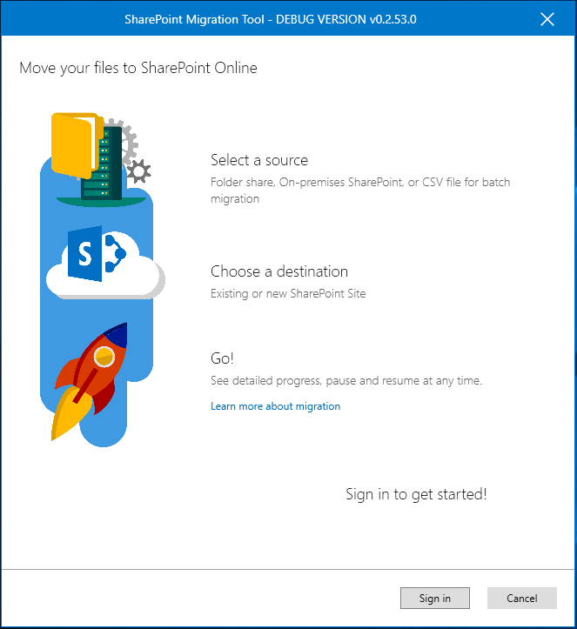
SharePoint Migration Tool – Open Preview
Simple, and fast content migration solution
Migrate content from SharePoint 2013 document libraries and file shares to SharePoint or OneDrive in Office 365
Available for all Office 365 customers
Notes:
Included in your o365 subscription.
Goal is for you to have a first free entry tool to get your content to the cloud.

Slide 42
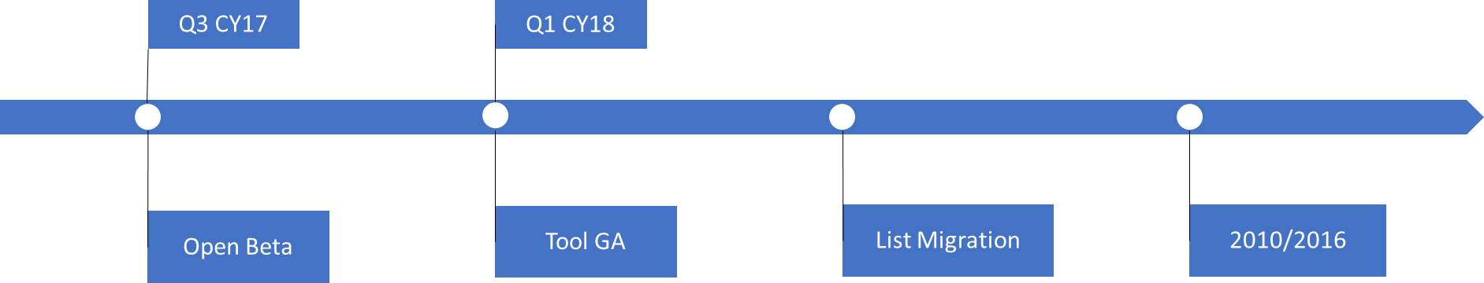
SharePoint Migration Tool Roadmap
Early 208
Available for all O365 customers as Open Beta
Try it now : Aka.ms/spmt

Slide 43
Migration Services

Slide 44



FastTrack
Paid Services
Free migration benefit for Office 365 customers
Includes MCS and 3rd party ISVs
Experts are great at making a plan for harder problems
Notes:
FastTrack benefit include
Content assessment
Planning and preparation guidance
Content migration
Testing and support
Infrastructure and licensing included at no cost

Slide 45



Journey to innovation - recap
SharePoint Server 2016 + Feature Packs
Hybrid
Migration

Slide 46
Q&A

